Slide 1
Cyber Bullying and Online Harassment
The need for stronger Legal Protection and Awareness
Presented by:
1.Mansi Bishoti 2.Garima Bhandari
3.Ashish Kunal 4.Prince Badola
5.Vishesh Jain 6.Kavya
7.Vivek 8.Yogesh Thapa

Slide 2
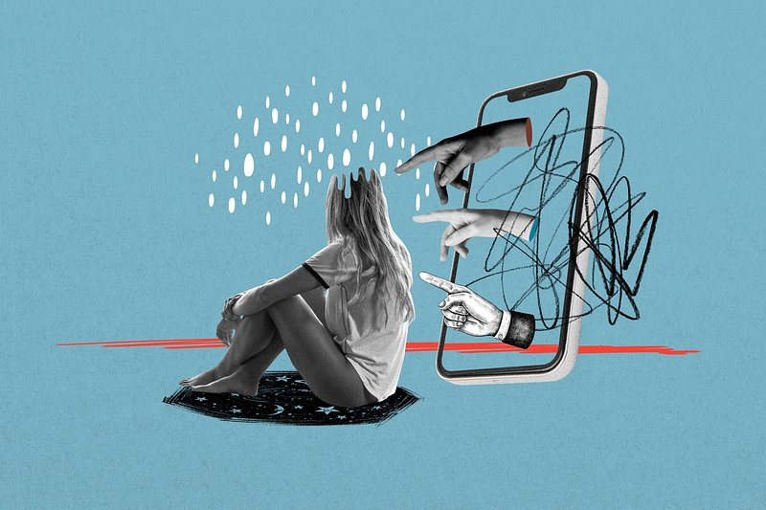
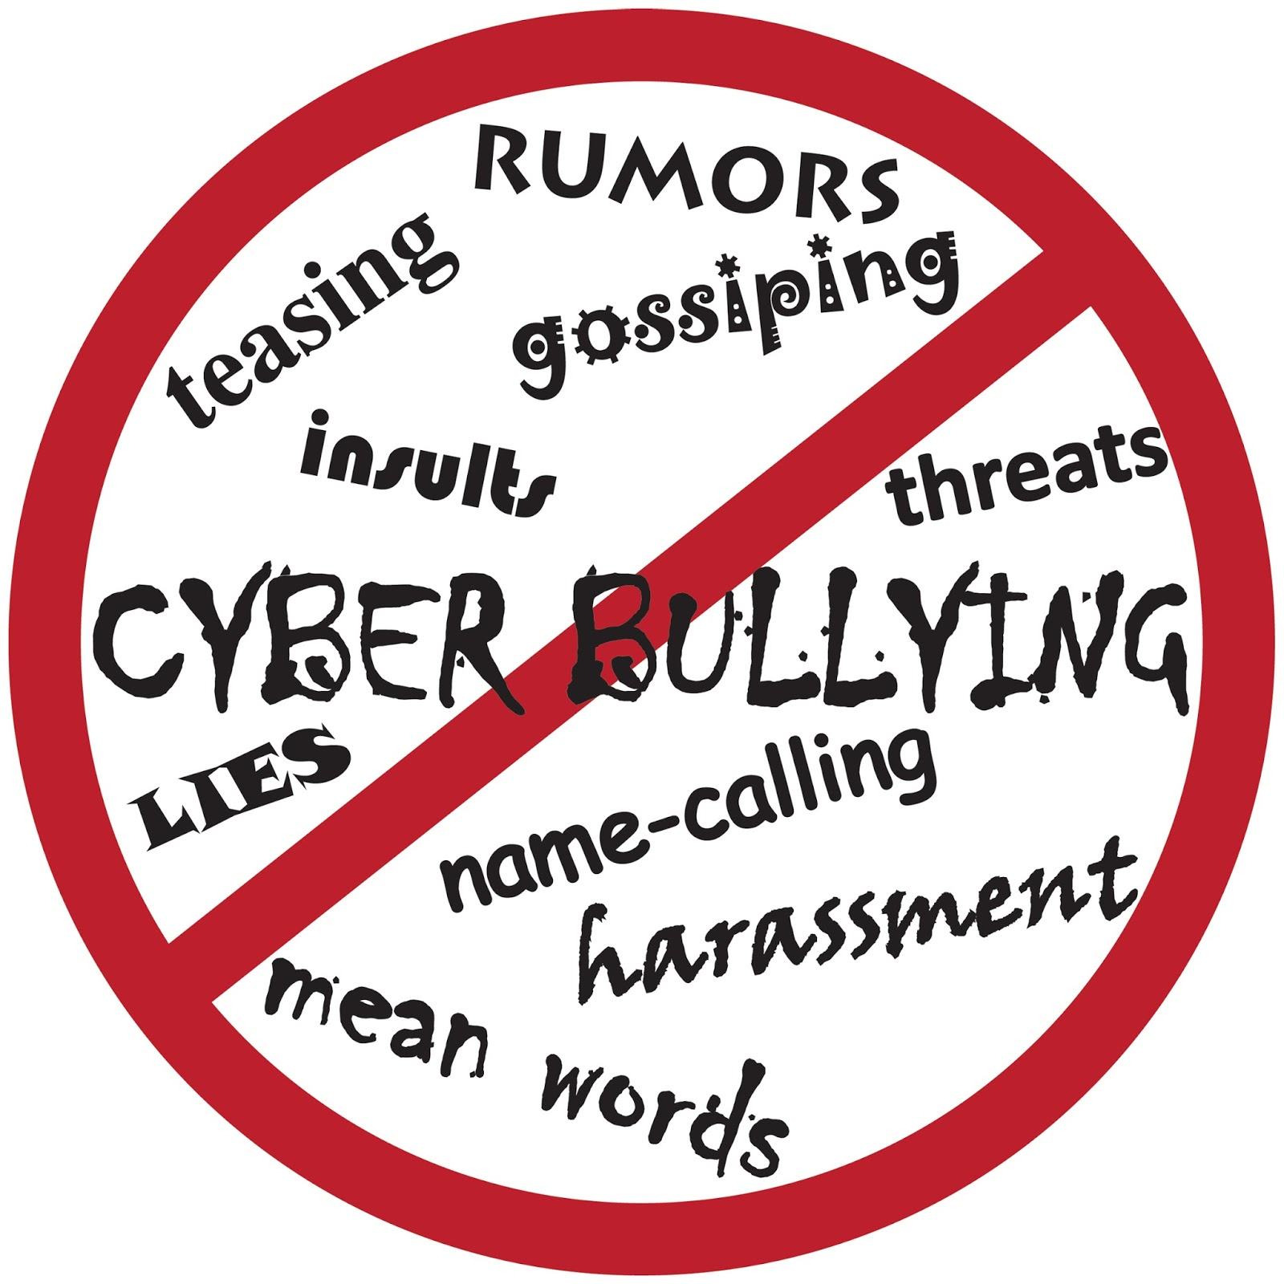
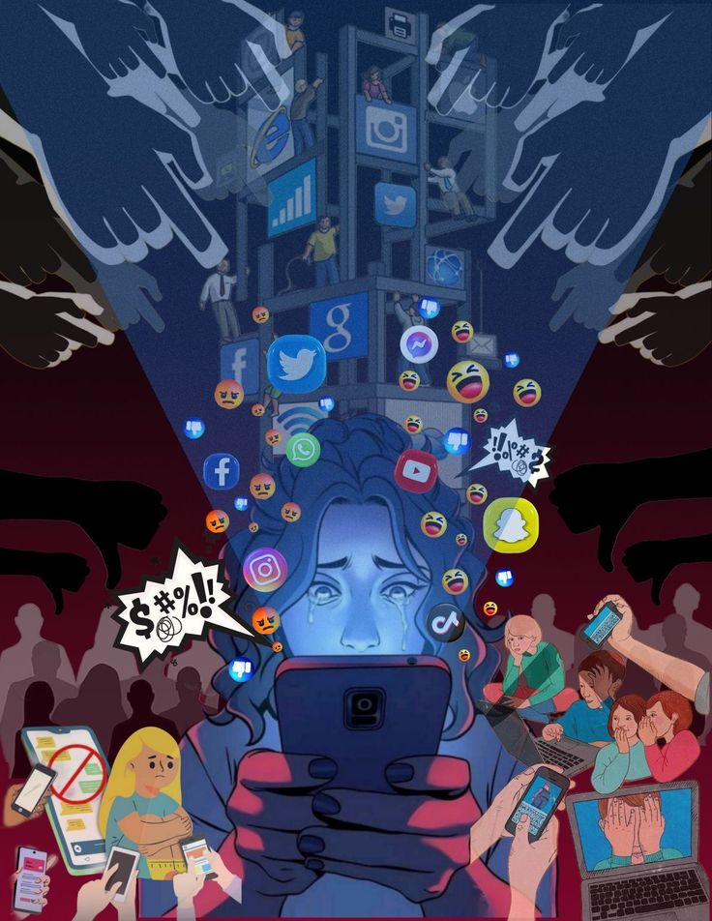
Understanding cyber-Bullying and Online Harassment
Using digital platforms to threaten or humiliate people.
Sending abusive texts, spreading rumors or sharing private photos without consent.
Involves stalking , blackmail or threats
Broader term covering repeated online behavior meant to harm others.
In India , cybercrime cases rose by more than 20% in recent years(NCRB report).
Many victims don’t know how to report or seek help
This Photo by Unknown Author is licensed under CC BY-SA-NC

Slide 3
Forms of Cyber-Bullying
• Harassment: Sending repeated, hurtful, or threatening messages online
• Flaming: Posting angry, rude, or hostile comments to start fights
• Outing: Sharing someone’s private information or secrets without permission
• Impersonation: Pretending to be someone else to damage their reputation
• Exclusion: Deliberately leaving someone out of online groups or chats
• Trolling: Deliberately provoking or upsetting someone for fun
• Cyberstalking: Continuously tracking and intimidating someone online
• Catfishing: Using a fake identity to deceive or emotionally manipulate someone
• Meme or Photo Misuse: Editing or sharing someone’s pictures to embarrass them

Slide 4
Psychological and Social Impact
Depression & Anxiety: 93% of cyber victims report feelings of hopelessness, sadness, and powerlessness
Suicidal Behavior: Cyberbullying victims are 1.9 times more likely to attempt suicide
Decreased Self-Esteem: 66% report cyberbullying negatively impacted how they feel about themselves
Trauma Symptoms: 32% experience at least one symptom of stress.
Social Consequences
Social Isolation: Victims report increased loneliness and withdrawal from peers
Relationship Disruption: 31% report damaged friendships and weaker emotional bonds
Trust Issues: Long-term difficulty forming relationships and social anxiety
Community Impact: Creates culture of fear and erodes sense of safety online
Psychological Impact

Slide 5
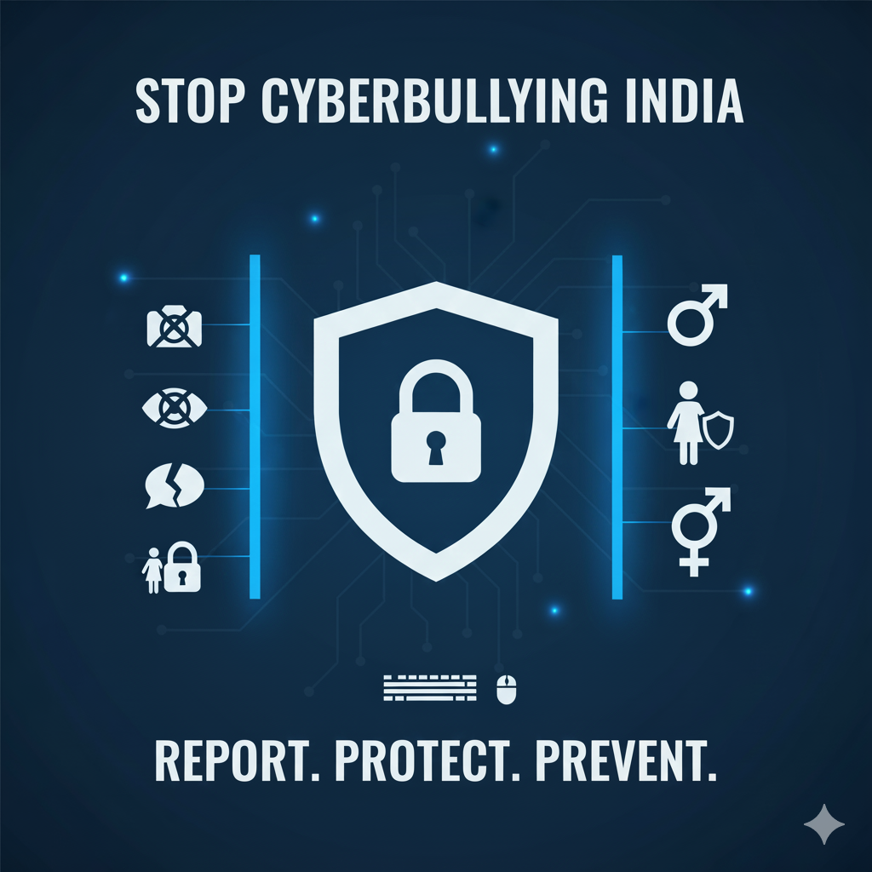
Laws against cyber-bullying and harassment
1. Information Technology Act, 2000
Section 66E: Punishes anyone who shares private images or videos of someone
without their permission.
Section 67: Punishes sharing offensive content online.
Section 67A: Punishes sharing sexually explicit material involving children.
2. Indian Penal Code (IPC), 1860
Section 354D: Punishes cyberstalking - following, harassing, or threatening
someone online.
Section 499: Deals with spreading false or hurtful information about someone.
Section 507: Punishes threatening someone online without showing your name.
Section 509: Punishes insulting a woman's dignity or modesty online.
3. Protection of Children from Sexual Offences (POCSO) Act, 2012
Protects children from sexual abuse online.
Applies if the victim is a minor (under 18 years).

Slide 6

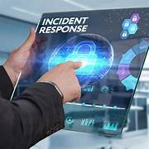
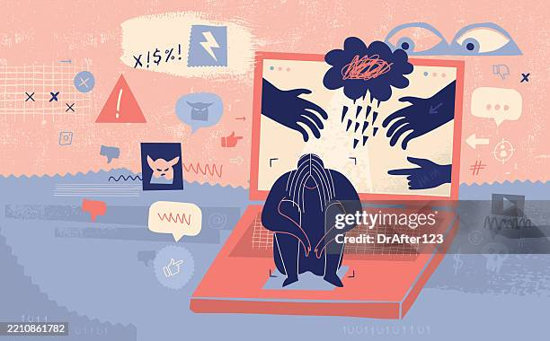
Gaps and limitations in current framework
⚖️ Legal Gaps
No dedicated cyberbullying law in India
Vague definitions of online abuse and harassment
IT Act not designed for psychological harm or social impact
2. 🚨 Enforcement Issues
Weak law enforcement and low digital literacy
Difficulty tracing anonymous offenders
Slow response to complaints and content removal
3. 🧠 Social Challenges
Mental health impact often ignored
Victims fear stigma, leading to underreporting

Slide 7
Solutions and preventive measures
. Think before you post and stay respectful online
• Block, report, and save evidence of cyberbullying
• Use privacy settings to protect your accounts
• Schools should run cyber safety and awareness programs
• Government must enforce stricter laws & fast complaint systems
• Tech platforms should improve filters and reporting tools

Slide 8
Role of education and awareness
Cyberbullying and online harassment are growing issues in the digital world.
Education helps by teaching:
•Safe and respectful online behavior.
• The importance of thinking before posting or sharing.
•Legal consequences of cyber abuse.
Awareness programs encourage:
•Recognizing and reporting cyberbullying.
• Supporting victims instead of ignoring them.
Schools and governments can organize cyber safety workshops and digital responsibility campaigns.
Educated and aware users make the internet a safer and more respectful space for everyone.

Slide 9
Conclusion and call to action
Conclusion:
Cyberbullying and online harassment have become serious threats in today’s digital world, affecting mental health, safety, and privacy.
Stronger legal frameworks and enforcement are essential to protect individuals from digital abuse.
Education, awareness, and responsible online behavior must go hand-in-hand with legal measures.
Building a safer internet requires collective effort — from lawmakers, platforms, and users alike.
What We Want the Audience to Do:
✅ Be aware of the impact of cyberbullying and take it seriously.
✅ Report any form of online harassment immediately to authorities or platform moderators.
✅ Support stronger laws and digital safety campaigns in your community.
✅ Educate peers about responsible and respectful online communication.
✅ Stand up against bullying — don’t be a bystander, be an ally.

